Slide 1
HealthConnect Clinic
Improving Patient Appointment Attendance and Healthcare Support Using Data and AI
Final Data Analytics Presentation
Tlotlo Oletile
Data Analytics Track | AnalystLab Africa Experience Lab

Slide 2
The Business Problem
HealthConnect aims to use data and AI to improve appointment attendance and patient support.
Missed patient appointments
Low appointment attendance
Underutilized appointment slots
Need for better administrative support
Need for evidence-based decision-making

Slide 3
My Data Analytics Contribution
Tools: Excel | Power BI | Python/Jupyter
Cleaned and analyzed appointment data
Developed and validated key performance indicators (KPIs)
Analyzed attendance and no-show patterns
Examined reminder status
Investigated appointment lead time
Developed dashboard visualizations
Translated findings into business recommendations
Week 7 output: Health Connect Appointment Dashboard – Advanced Analysis and Decision Support.

Slide 4
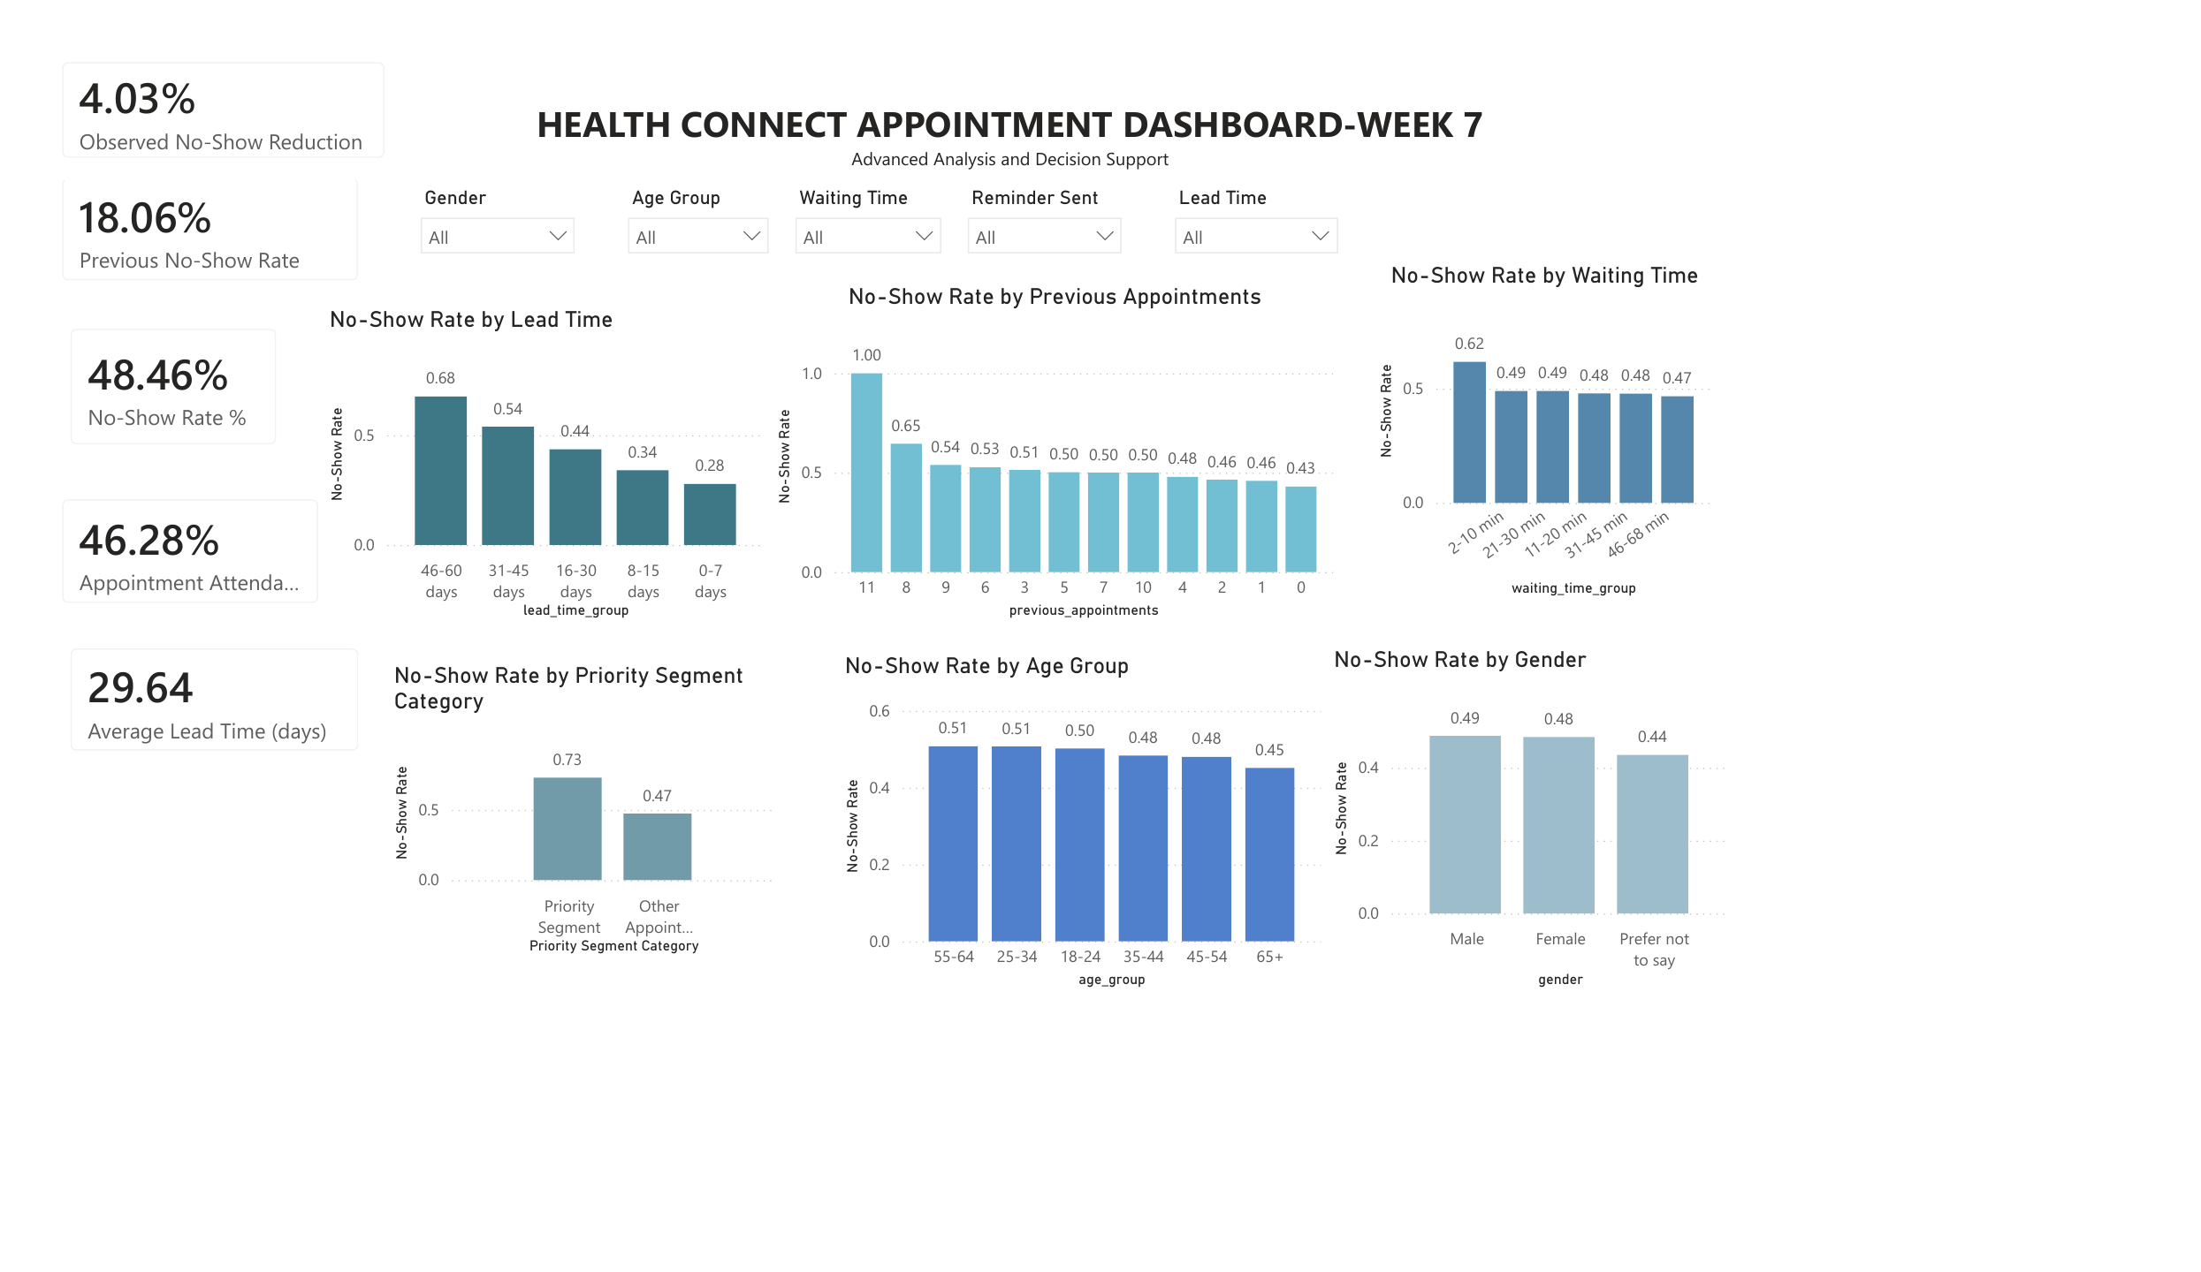
My Week 7 Data Analytics Dashboard
Health Connect Appointment Dashboard – Week 7 | Advanced Analysis and Decision Support

Slide 5
Final KPIs
Validated indicators for the final decision-support output.
NO-SHOW RATE: 48.46%
ATTENDANCE RATE: 46.28%
CANCELLATION RATE: 5.26%
AVERAGE APPOINTMENT LEAD TIME: 29.64 DAYS
PREVIOUS NO-SHOW RATE: 18.06%
OBSERVED REDUCTION IN NO-SHOW RATE: 4.03 PERCENTAGE POINTS

Slide 6
Key Findings
The no-show rate of 48.46% indicates a significant missed-appointment challenge.
Attendance was 46.28%, highlighting an opportunity to improve appointment utilization.
Cancellations were a separate outcome at 5.26%.
Reminder = No: 51.39%; Reminder = Yes: 47.36%.
The reminder comparison shows an association in the available data, not proof of causation.
Average appointment lead time was 29.64 days.

Slide 7
Business Insights & Recommendations
What the dashboard tells us — and what HealthConnect can do next
01
Longer lead time = higher no-shows
02
Priority appointments show higher risk
No-show rate rises from 28% at 0–7 days to 68% at 46–60 days.
Priority appointments recorded a 73% no-show rate versus 47% for other appointments.
Recommendation: review long booking lead times and consider earlier follow-up for appointments scheduled far in advance.
Recommendation: review priority appointment workflows and add targeted confirmation/follow-up.
03
Waiting time also shows variation
04
Patterns are broad, not limited to one demographic
No-show rates vary across waiting-time groups, reaching 62% in the 2–10 minute group.
No-show rates vary by age and gender, but the dashboard does not show a single demographic explaining the overall problem.
Recommendation: investigate the operational factors behind waiting-time differences before changing processes.
Recommendation: prioritize appointment-process factors while using demographic patterns for further investigation, not assumptions.
Key takeaway: Focus intervention on appointment-process factors identified by the data, especially long lead times and priority appointments.

Slide 8
Cross-Track Integration
DATA ANALYTICS → DATA SCIENCE: Validated attendance and no-show findings support model interpretation.
DATA ANALYTICS → PROJECT MANAGEMENT: Final KPIs, insights and recommendations support project decisions and presentation.
ALL TRACKS → HEALTHCONNECT: Individual outputs combine into one integrated solution.
Final integration focuses on using outputs from different tracks, not communication alone.

Slide 9
Individual Contribution & Project Scope
My contribution was completed within the Data Analytics track.
I developed and refined the appointment analytics and dashboard independently.
I validated the key KPIs and analyzed attendance, no-shows, cancellations, reminders and appointment lead time.
I translated the analytical findings into business insights and recommendations.
No cross-track collaboration or exchange of outputs was completed as part of my contribution.
The presentation therefore focuses on my actual Data Analytics work and the final outputs I produced.

